Slide 1
SGS RPO – 5G System File Creation
25 January 2023

Slide 2
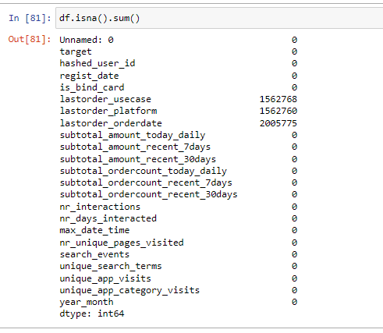

Slide 3
GNODEB

Slide 4
GNODEB

Slide 5
GNODEB

Slide 6
GNODEB

